Slide 1
Randomized Algorithms CS648
Lecture 21
Miscellaneous applications of Backward analysis

Slide 2
problem 1 SMALLEST Enclosing circle

Slide 3
Smallest Enclosing Circle

Slide 4

Smallest Enclosing Circle
Question:
Suppose we sample $k$ points randomly uniformly from a set of $n$points,
what is the expected no. of points that remain outside the smallest circle
enclosing the sample?

Slide 5
problem 2 smallest length interval

Slide 6

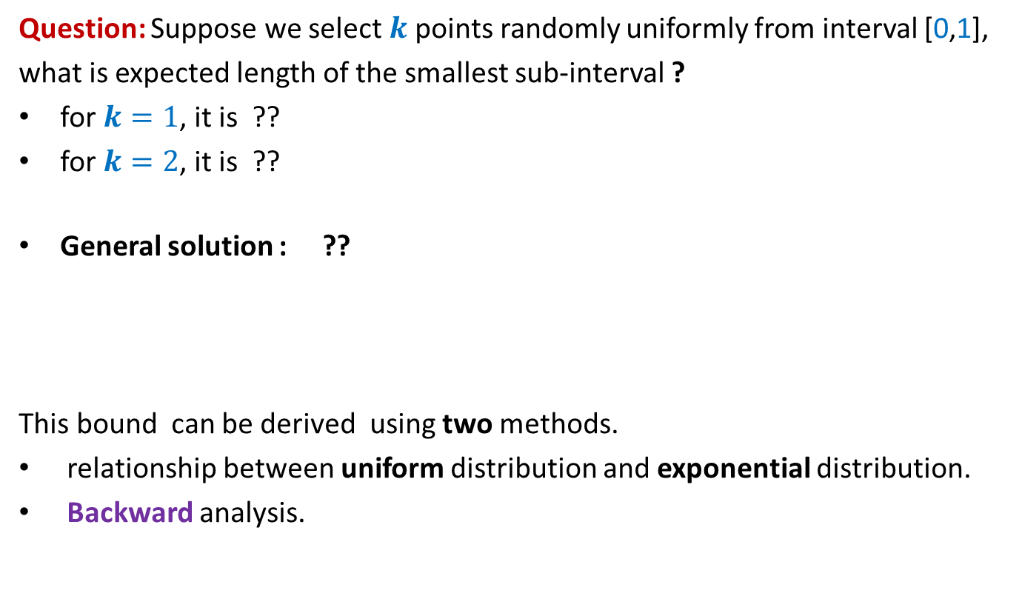
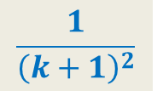

Sampling points from a unit interval
Question: Suppose we select $k$points randomly uniformly from interval [0,1],
what is expected length of the smallest sub-interval ?
for $k=1$, it is ??
for $k=2$, it is ??
General solution : ??
This bound can be derived using two methods.
relationship between uniform distribution and exponential distribution.
Backward analysis.
$\frac{1}{4}$
$\frac{1}{9}$
$$\frac{1}{{\left(k+1\right)}^{2}}$$
0
1

Slide 7
problem 3 Minimum spanning tree

Slide 8
Minimum spanning tree
16
d
17
9
h
v
4
2
5
x
19
6
11
y
22
3
3
c
12
a
18
1
10
u
15
b
7
13

Slide 9
Minimum spanning tree
16
d
17
9
h
v
4
2
5
x
19
6
11
y
22
3
3
c
12
a
18
1
10
u
15
b
7
13

Slide 10

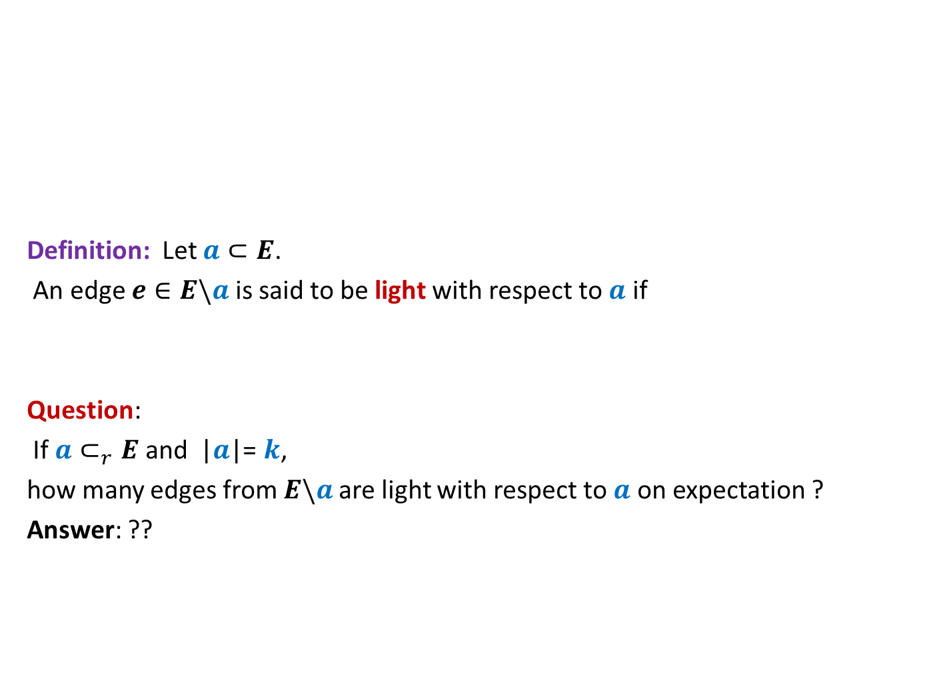

Light Edge
16
d
17
9
Definition: Let $a⊂E$.
An edge $e∈E\backslash a$ is said to be light with respect to $a$ if
Question:
If $a⊂_{r}E$ and |$a$|= $k$,
how many edges from $E\backslash a$ are light with respect to $a$ on expectation ?
Answer: ??
h
v
4
2
5
x
19
6
11
y
22
3
3
c
12
a
18
1
10
u
15
b
7
13
MST($\{e\}∪a$) $≠$ MST($a$)
$$<\frac{n}{k}(m−k)$$

Slide 11
using Backward analysis for The 3 problems : A General framework

Slide 12

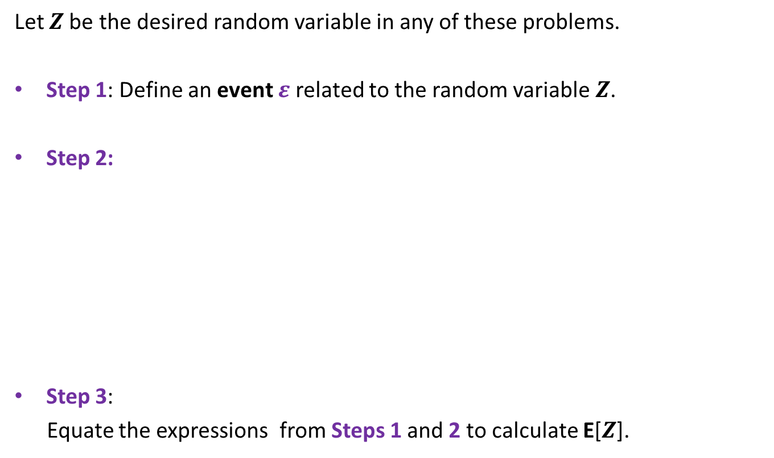
A General framework
Let $Z$be the desired random variable in any of these problems.
Step 1: Define an event $ε$ related to the random variable $Z$.
Step 2:
Step 3:
Equate the expressions from Steps 1 and 2 to calculate E[$Z$].
Calculate P[$ε$]
Using
Standard Definition
Using
Bakward Analysis

Slide 13

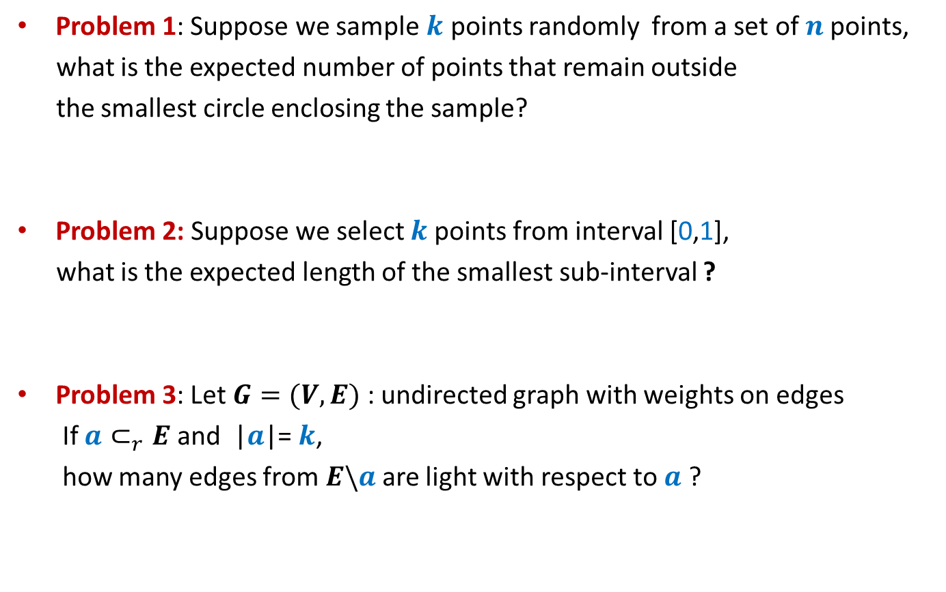
3 Problems
Problem 1: Suppose we sample $k$ points randomly from a set of $n$points,
what is the expected number of points that remain outside
the smallest circle enclosing the sample?
Problem 2: Suppose we select $k$points from interval [0,1],
what is the expected length of the smallest sub-interval ?
Problem 3: Let $G=(V,E)$ : undirected graph with weights on edges
If $a⊂_{r}E$ and |$a$|= $k$,
how many edges from $E\backslash a$ are light with respect to $a$ ?
MST($a$)

Slide 14
problem 3 Minimum spanning tree

Slide 15
A Better understanding of light edges

Slide 16


Minimum spanning tree
16
d
$$(V,E)$$
17
19
h
v
4
2
5
x
19
6
31
11
y
22
3
3
c
42
a
18
1
10
u
15
b
7
13
Random sampling
16
d
$$(V,R)$$
h
v
4
5
x
19
31
11
y
22
c
a
18
1
10
u
15
b

Slide 17

Minimum spanning tree
16
d
$$(V,E)$$
17
19
h
v
4
2
5
x
19
6
31
11
y
22
3
3
c
42
a
18
1
10
u
15
b
7
13
16
d
MST($R$)
$$(V,R)$$
h
v
4
5
x
19
31
11
y
22
c
a
18
1
10
u
15
b

Slide 18

Minimum spanning tree
16
d
$$(V,E)$$
17
19
h
v
4
2
5
x
19
6
31
11
y
22
3
3
c
42
a
18
1
10
u
15
b
7
23
16
d
MST($R$)
$$(V,R)$$
17
19
h
v
4
2
5
x
19
$$E\backslash R$$
6
11
y
3
3
c
42
a
1
10
u
15
b
7
23

Slide 19
Minimum spanning tree
16
d
$$(V,E)$$
17
19
h
v
4
2
5
x
19
6
31
11
y
22
3
3
c
42
a
18
1
10
u
15
b
7
23
16
d
MST($R$)
$$(V,R)$$
17
19
h
v
4
2
5
x
19
$$E\backslash R$$
6
11
y
3
3
c
42
a
Light
1
10
u
15
b
7
23

Slide 20
Minimum spanning tree
16
d
$$(V,E)$$
17
19
h
v
4
2
5
x
19
6
31
11
y
22
3
3
c
42
a
18
1
10
u
15
b
7
23
16
d
MST($R$)
$$(V,R)$$
17
19
h
v
4
2
5
x
19
$$E\backslash R$$
6
11
y
3
3
c
42
a
Light
heavy
1
10
u
15
b
7
23

Slide 21

First useful insight
Lemma1: An edge $e$ is light with respect to $a⊂E$
if and only if
$e$ belongs to MST($\left\{e\right\}∪a$).

Slide 22

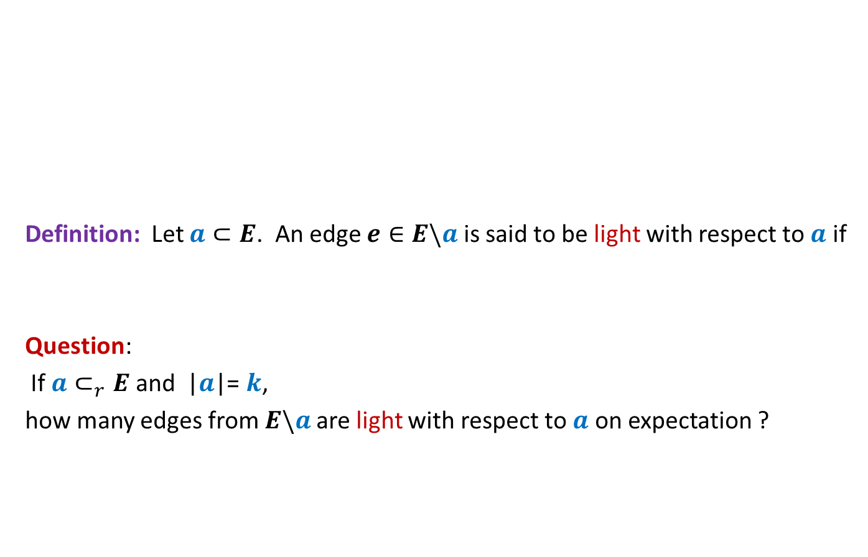
Solving Problem 3
16
d
17
9
Definition: Let $a⊂E$. An edge $e∈E\backslash a$ is said to be light with respect to $a$ if
Question:
If $a⊂_{r}E$ and |$a$|= $k$,
how many edges from $E\backslash a$ are light with respect to $a$ on expectation ?
h
v
4
2
5
x
19
6
31
11
y
22
3
3
c
12
a
18
1
10
u
15
b
7
13
MST($\{e\}∪a$) $≠$ MST($a$)
Understanding the random variable first

Slide 23





$$k$$
$$R$$
MST($R$)
$$E\backslash R$$

Slide 24
$$k$$
$$R$$
MST($R$)
$$E\backslash R$$
Light

Slide 25
$$k$$
$$R$$
MST($R$)
$$E\backslash R$$
Light
heavy

Slide 26


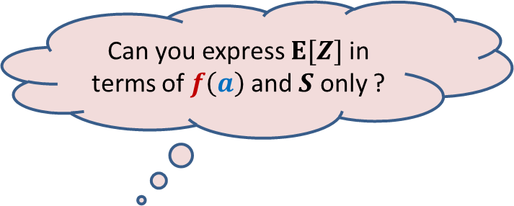
$Z$: random variable for the number of light edges in $E\backslash R$
when$R$ is a random sample of $k$ edges.
$S$: set of all subsets of $E$ of size $k$.
$f\left(a\right)$ : number of light edges in $E\backslash R$ when $R=a$.
$E[Z]$ = ??
$$\frac{1}{|S|}\sum_{a∈S}{f\left(a\right)}$$
Can you express $E[Z]$ in terms of $f\left(a\right)$ and $S$ only ?

Slide 27

Step 1
Let $R$ be a uniformly random sample of $k$ edges from $E$.
event $ε$ : ?
Let $p$ = P[$ε$]
an edge selected randomly from $E\backslash R$ is a light edge

Slide 28

Step 2.1
Calculating $p$using definition

Slide 29






Step 2.1
Calculating $p$using definition
$$k$$
$$a$$
$\left(m−k\right)$
Light edges
=$f\left(a\right)$
MST($a$)
$$E\backslash a$$
Light
heavy

Slide 30
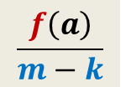
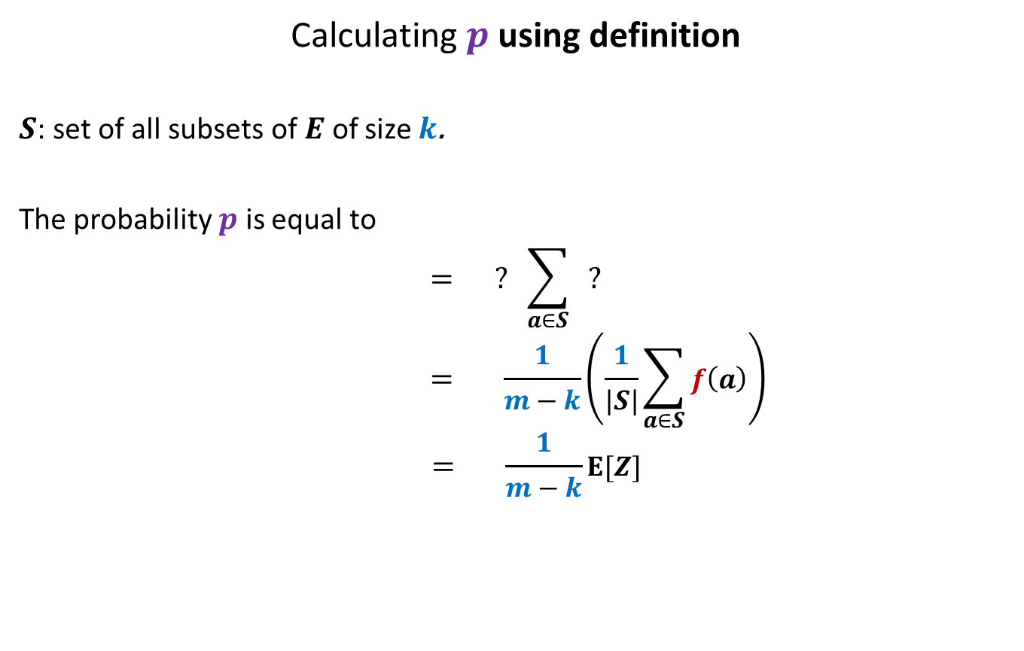

Step 2.1
Calculating $p$using definition
$S$: set of all subsets of $E$ of size $k$.
The probability $p$ is equal to
$$= ? \sum_{a∈S}{ ?}$$
$$= \frac{1}{m−k}\left(\frac{1}{|S|}\sum_{a∈S}{f\left(a\right)}\right)$$
$$= \frac{1}{m−k}E[Z]$$
$$\frac{1}{|S|}$$
$$\frac{f\left(a\right)}{m−k}$$

Slide 31
Step 2.2
Expressing the entire experiment as Randomized Incremental Construction
A slight difficulty in this process is the following:
The underlying experiment talks about random sample from a set.
But RIC involves analyzing a random permutation of a set of elements.
➔
Question: What is relation between random sample from a set and a random permutation of the set ?
Spend some time on this question before proceeding further.

Slide 32


Step 2.2
Calculating $p$using Backward Analysis
?
Random sample of size $k$
Random permutation of input

Slide 33
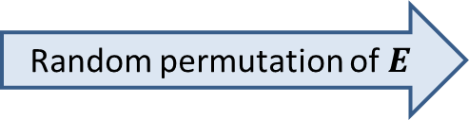

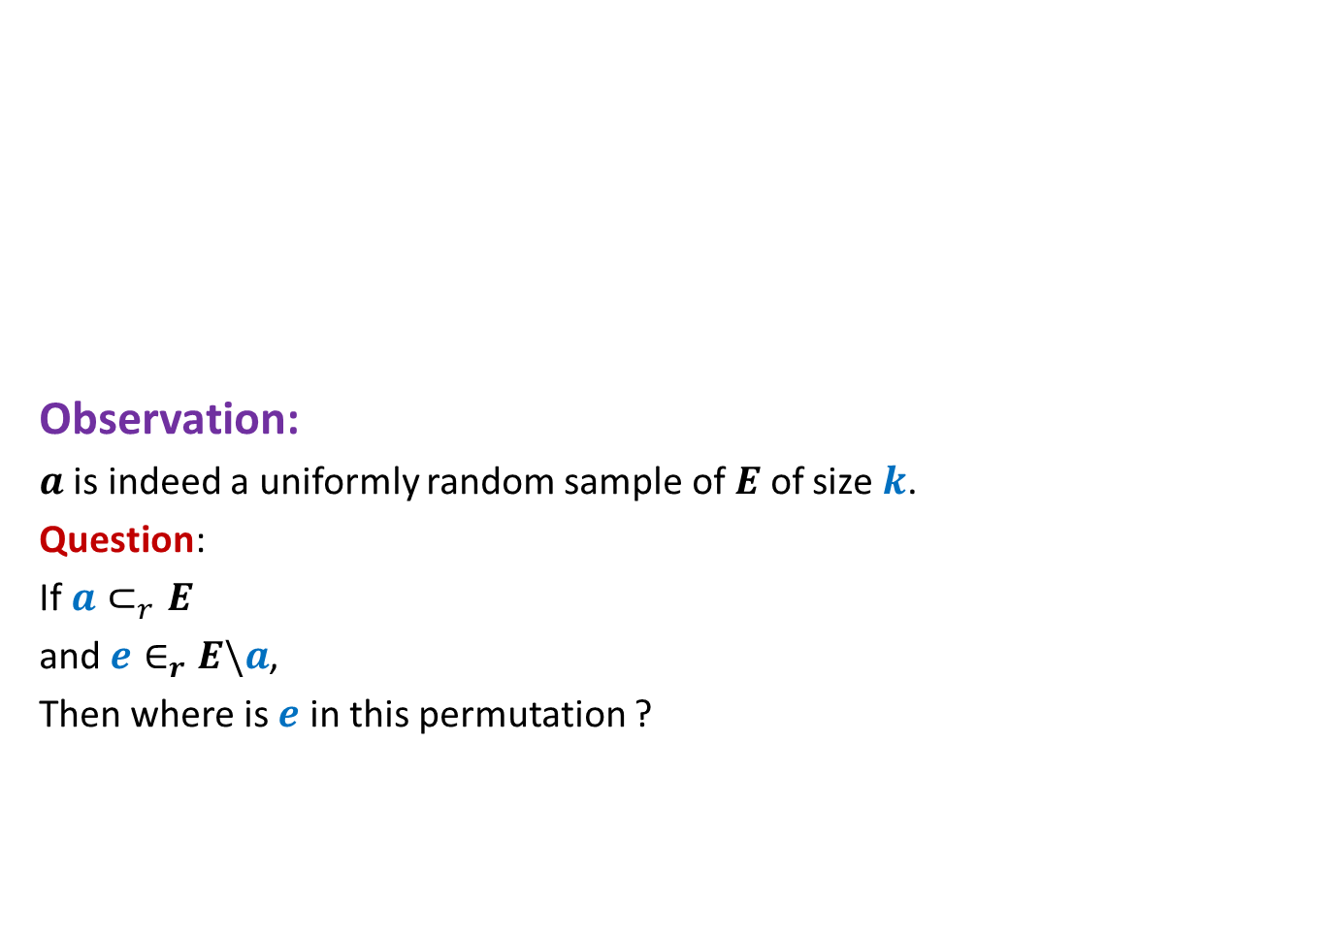



random sample and random permutation
Random permutation of $E$
Observation:
$a$ is indeed a uniformly random sample of $E$ of size $k$.
Question:
If $a⊂_{r}E$
and $e∈_{r}E\backslash a$,
Then where is $e$ in this permutation ?
$$a$$
$$E\backslash a$$
$$k$$
$$m−k$$

Slide 34
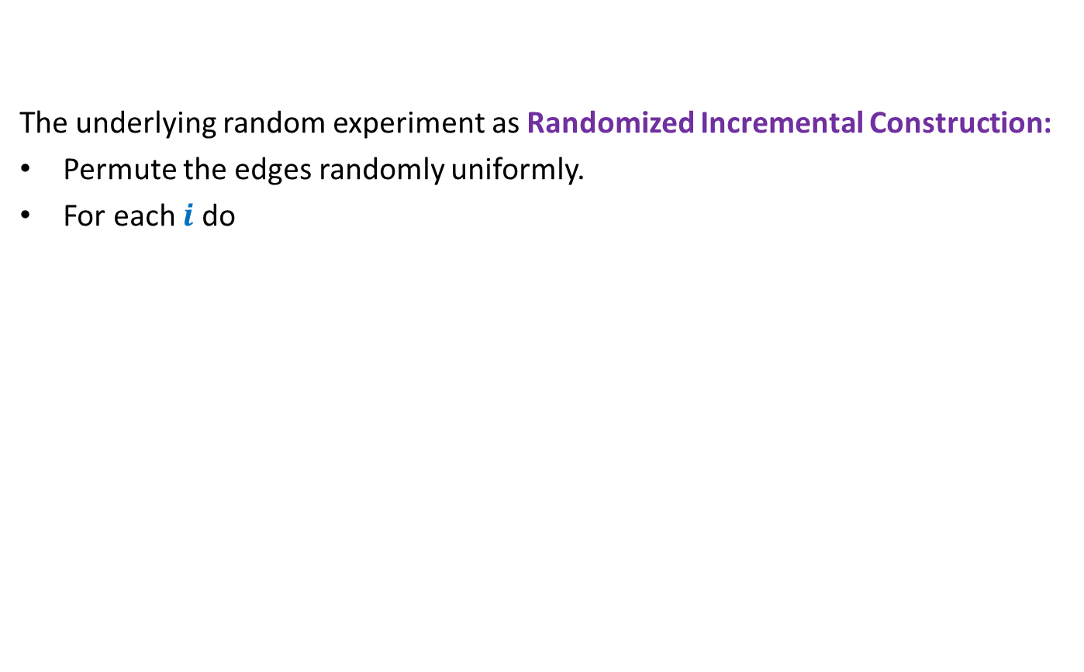

Step 2.2
The underlying random experiment as Randomized Incremental Construction:
Permute the edges randomly uniformly.
For each $i$ do
Determine if $i$th edge is light relative to the first $i−1$ edges.
Can you now calculate probability $p$?

Slide 35





Step 2.2
Random permutation of $E$
…
$$e_{i}$$
$$e_{1}$$
$$e_{2}$$
$$E_{i−1}$$

Slide 36


Step 2.2
Random permutation of $E$
$X_{i}$:
a random variable taking value 1 if $e_{i}$ is a light edge with respect to MST($E_{i−1}$).
…
$$e_{i}$$
$$e_{1}$$
$$e_{2}$$
$$E_{i−1}$$
$$E\backslash E_{i−1}$$

Slide 37


Step 2.2
Random permutation of $E$
$X_{i}$:
a random variable taking value 1 if $e_{i}$ is a light edge with respect to MST($E_{i−1}$).
Question: What is relation between $p$and $X_{i}$’s?
Answer: ??
…
$$e_{i}$$
$$e_{1}$$
$$e_{2}$$
$$E_{i−1}$$
$$E\backslash E_{i−1}$$
$$p={P(X}_{k+1}=1\text{).}$$

Slide 38



Calculating ${P(X}_{i}=1$).
Random permutation of $E$
$S_{i−1}$: set of all subsets of $E$ of size $i−1$.
${P(X}_{i}=1$) =
$\sum_{a∈S_{i−1}}{ {P(X}_{i}=1\left|E_{i−1}=a\right)∙P(E_{i−1}=a) }$
☹ depends upon $a$
…
$$e_{i}$$
$$e_{1}$$
$$e_{2}$$
$$E_{i−1}$$
Forward analysis
MST($a$)

Slide 39



Calculating ${P(X}_{i}=1$).
Random permutation of $E$
$S_{i}$: set of all subsets of $E$ of size $i$.
${P(X}_{i}=1$)=
$\sum_{a∈S_{i}}{ {P(X}_{i}=1\left|E_{i}=a\right)∙P(E_{i}=a) }$
…
$$e_{i}$$
$$e_{1}$$
$$e_{2}$$
$$E_{i}$$
Backward analysis

Slide 40



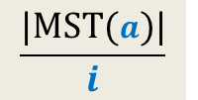
$${P(X}_{i}=1\left|E_{i}=a\right)$$
Random permutation of $E$
${P(X}_{i}=1\left|E_{i}=a\right)$
= ??
$=$ ??
$≤\frac{n−1}{i}$
…
$$e_{i}$$
$$e_{1}$$
$$e_{2}$$
$$E_{i}$$
Backward analysis
Use Lemma 1.
$$P\left(ith edge belongs to MST(a)\right)$$
$$\frac{|MST(a)|}{i}$$
MST($a$)
There are total $i$ possible edges that can occupy $i$th place.
What is the probability that one of the edges of the $MST(a)$ occupies $i$th place ?

Slide 41


Calculating ${P(X}_{i}=1$)
Random permutation of $E$
$S_{i}$: set of all subsets of $E$ of size $i$.
${P(X}_{i}=1$)=
$\sum_{a∈S_{i−1}}{ {P(X}_{i}=1\left|E_{i}=a\right)∙P(E_{i}=a) }$
$≤\sum_{a∈S_{i−1}}{\frac{n−1}{i}P(E_{i}=a) }$
$=\frac{n−1}{i}\sum_{a∈S_{i−1}}{ P(E_{i}=a) }$
$=\frac{n−1}{i}$
…
$$e_{i}$$
$$e_{1}$$
$$e_{2}$$
$$E_{i}$$
Backward analysis

Slide 42

Step 3
Using method 1:
$$p = \frac{1}{m−k}E[Z]$$
Using method 2:
$p =$ ${P(X}_{k+1}=1$)
$$<\frac{n−1}{k+1}$$
Hence:
$E[Z]$ $<\frac{n−1}{k+1}$ $(m−k)$
$≤\frac{n}{k}$ $(m−k)$

Slide 43
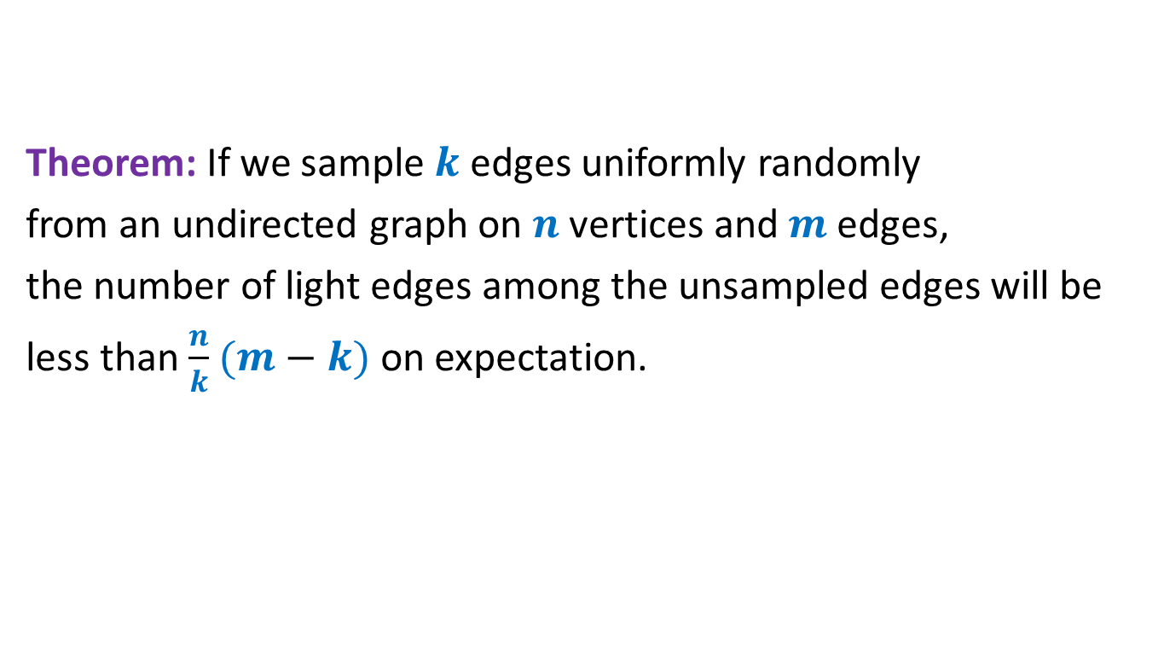
Theorem: If we sample $k$ edges uniformly randomly
from an undirected graph on $n$vertices and $m$edges,
the number of light edges among the unsampled edges will be
less than $\frac{n}{k}$ $(m−k)$ on expectation.

Slide 44




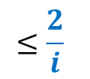



Smallest Enclosing Circle Problems
Problem 1: Suppose we sample $k$ points randomly from a set of $n$points,
what is the expected number of points that remain outside
the smallest circle enclosing the sample?
Event $ε$ :
$i$th point changes the smallest enclosing circle
Using Backward Analysis
Using Standard definition
P[$ε$]
$$≤\frac{2}{i}$$
P[$ε$| first $i−1$ points are $P$]
$$=Z_{P}/(n−i+1)$$
Homework: Compute E[$Z$]

Slide 45







Sampling points from a unit interval
Question: Suppose we select $k$points randomly uniformly from interval [0,1],
what is expected length of the smallest sub-interval ?
Event $ε$ :
$i$th point changes the smallest interval length
0
1
$$Δ_{i−1}$$
Using Backward Analysis
Using Standard definition
P[$ε$]
$$≤\frac{2}{i}$$
$$\left(i+1\right)Δ_{i−1}≤$$
P[$ε$| first $i−1$ points are $P$]
$$≤(2i+2)Δ_{i−1}$$
Homework: Compute E[$Z$]

